Slide 1
Three Kings Day Celebration
Spanish Club’s involvement in the

Slide 2
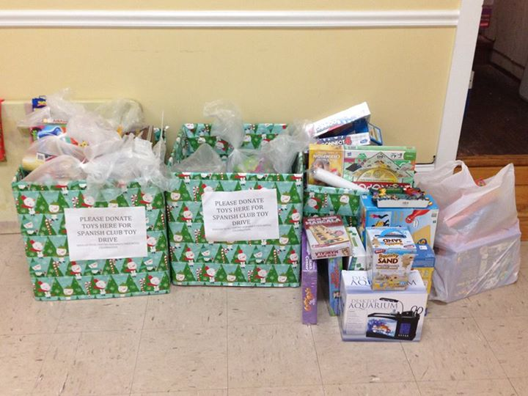
Spanish Club’s toy drive at the high school from the beginning of November until school let out for vacation in late December.

Slide 3
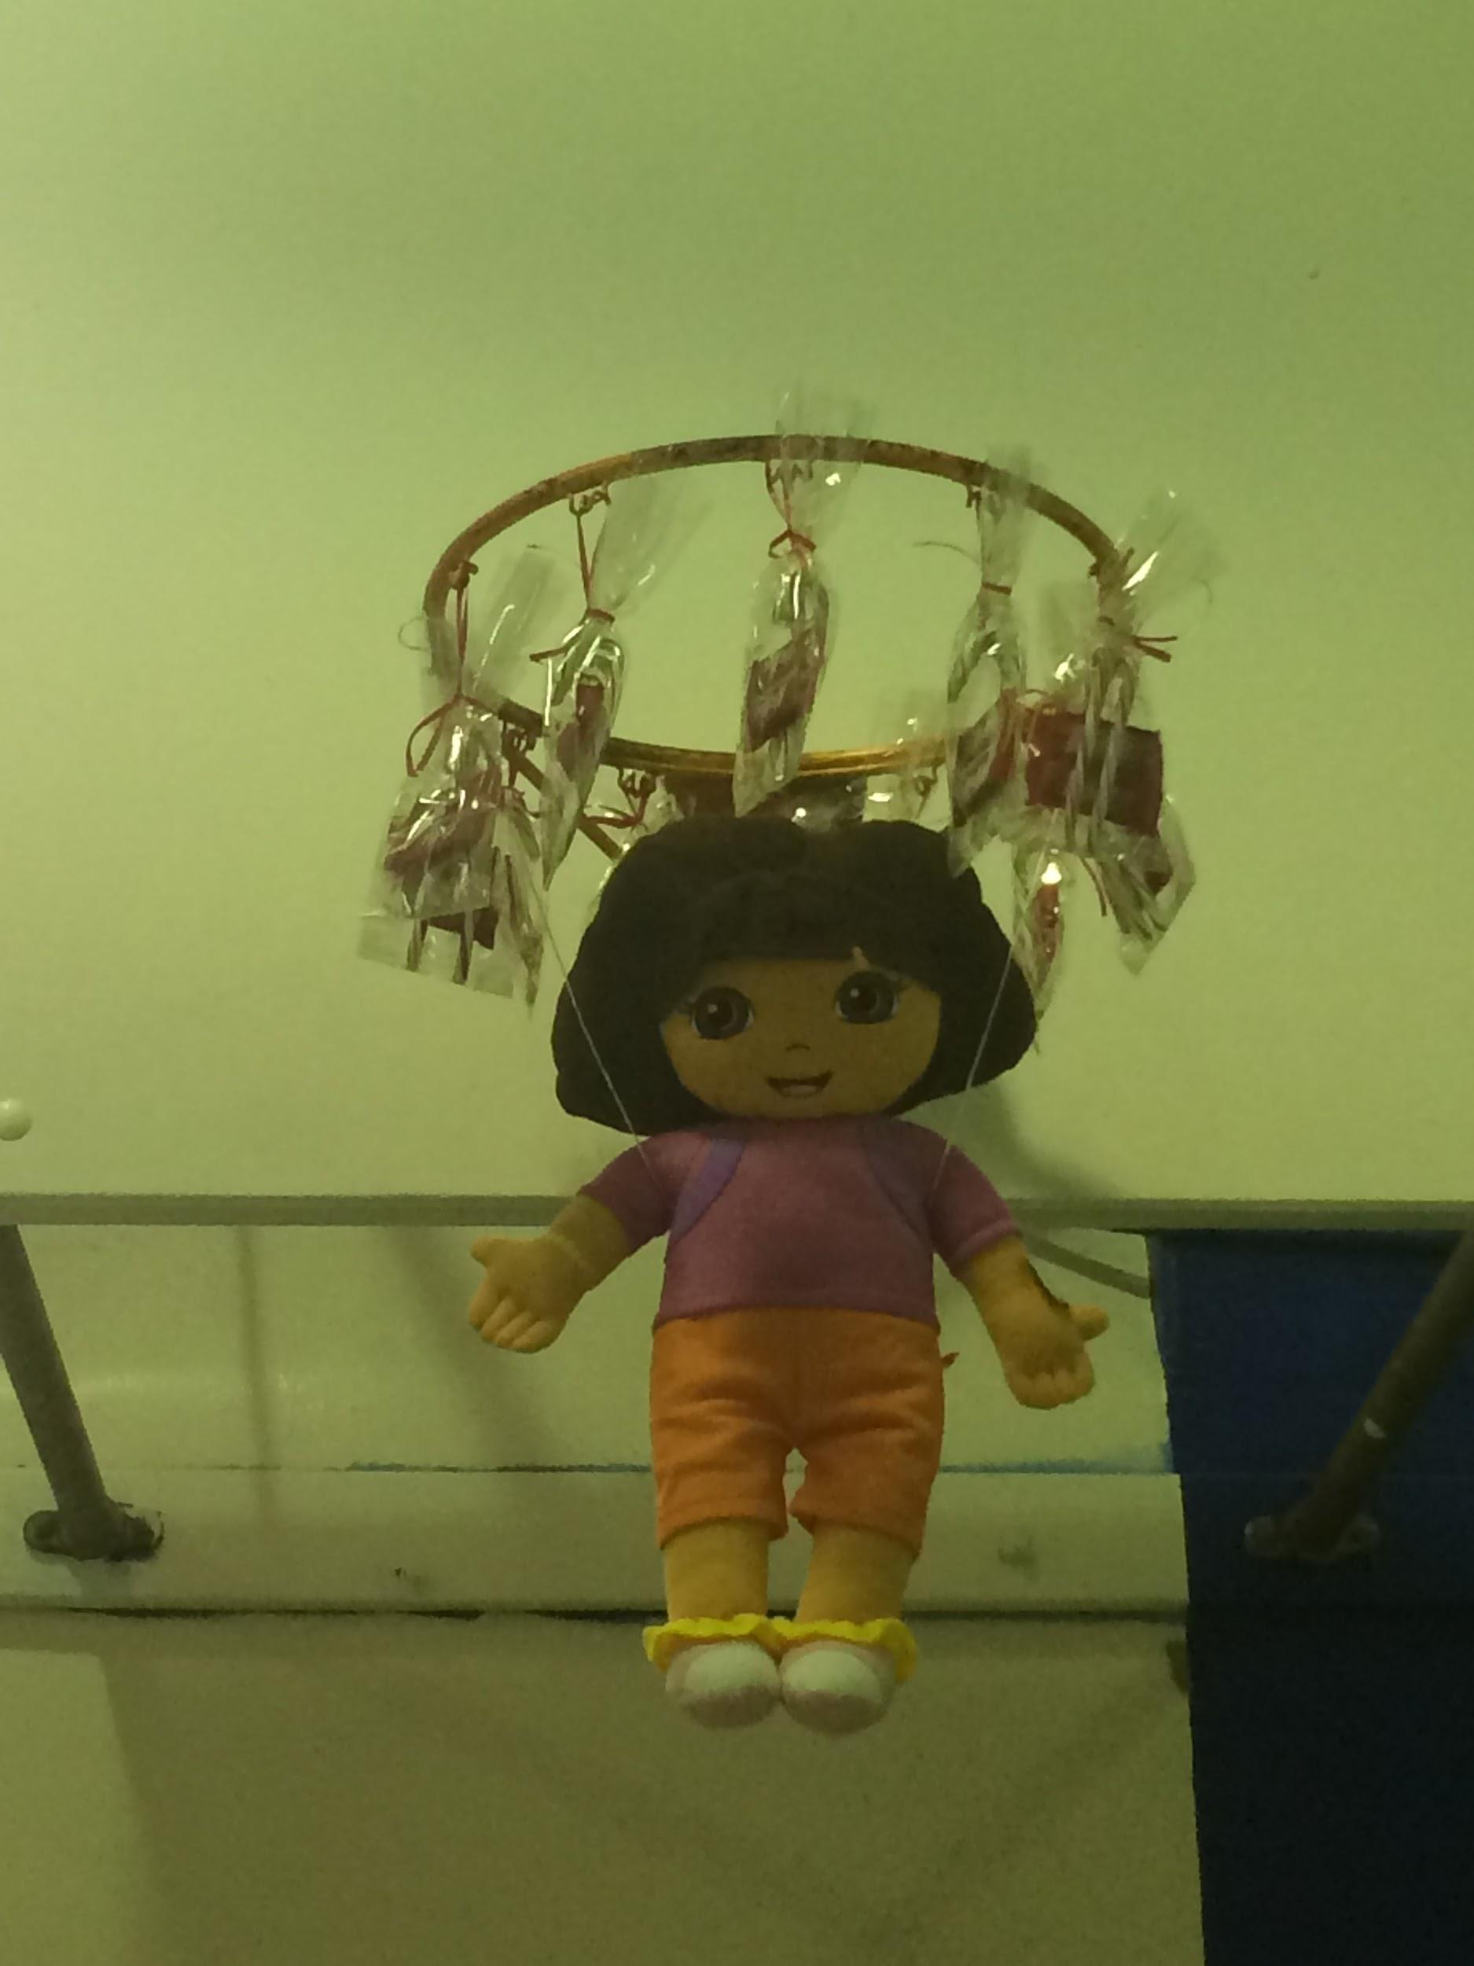
Candy canes donated by the Freshman class government used as decoration.

Slide 4
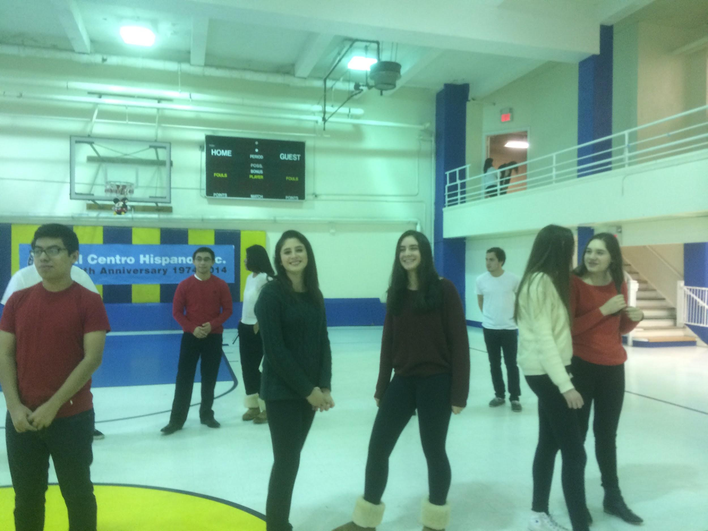
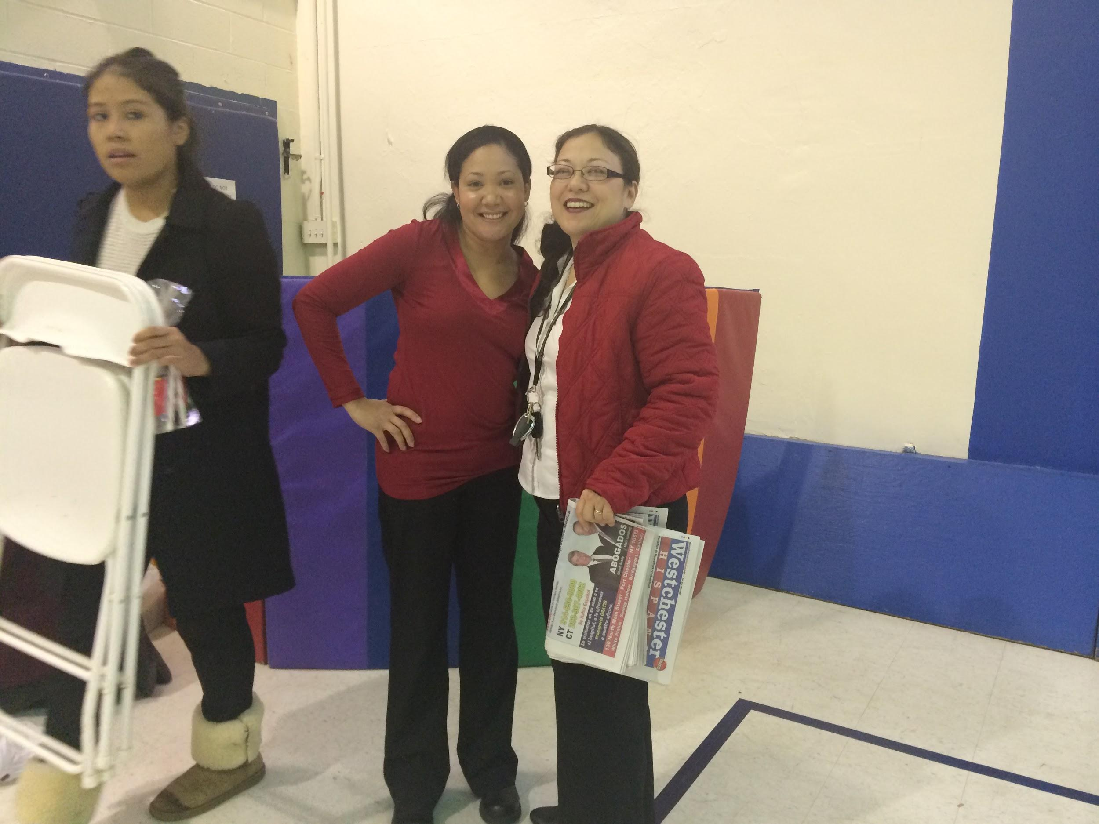

Slide 5
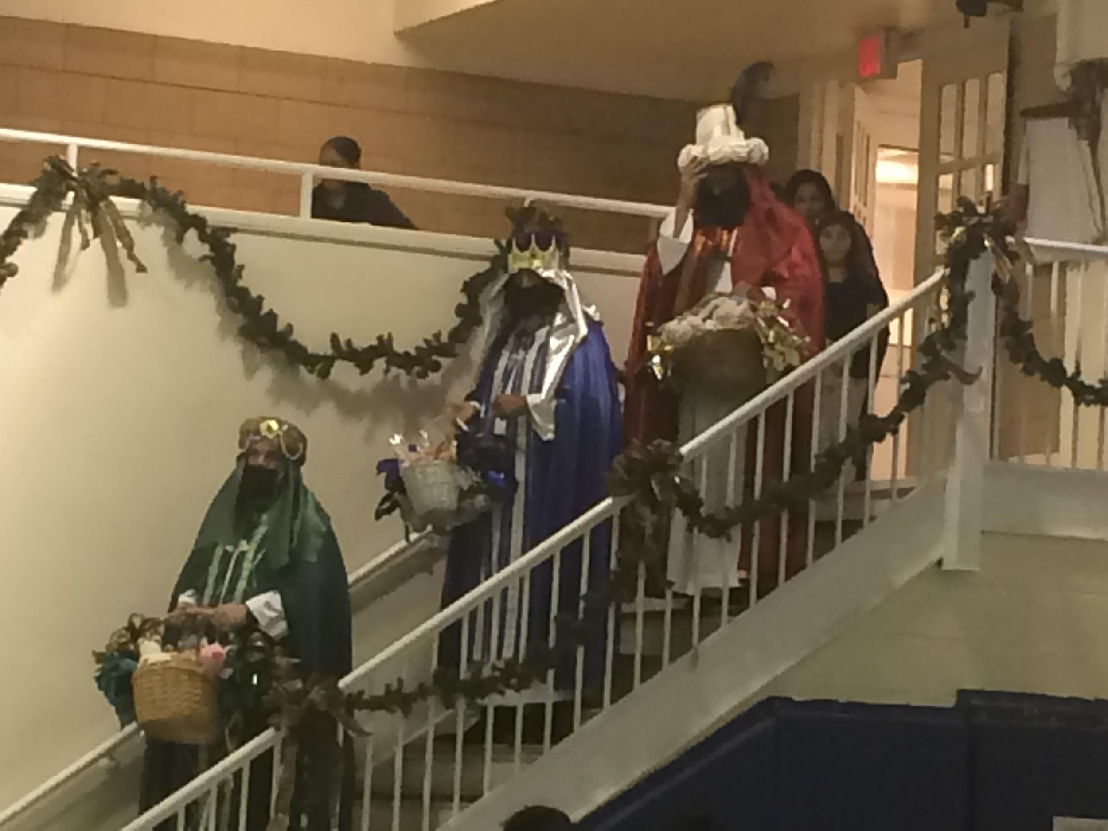
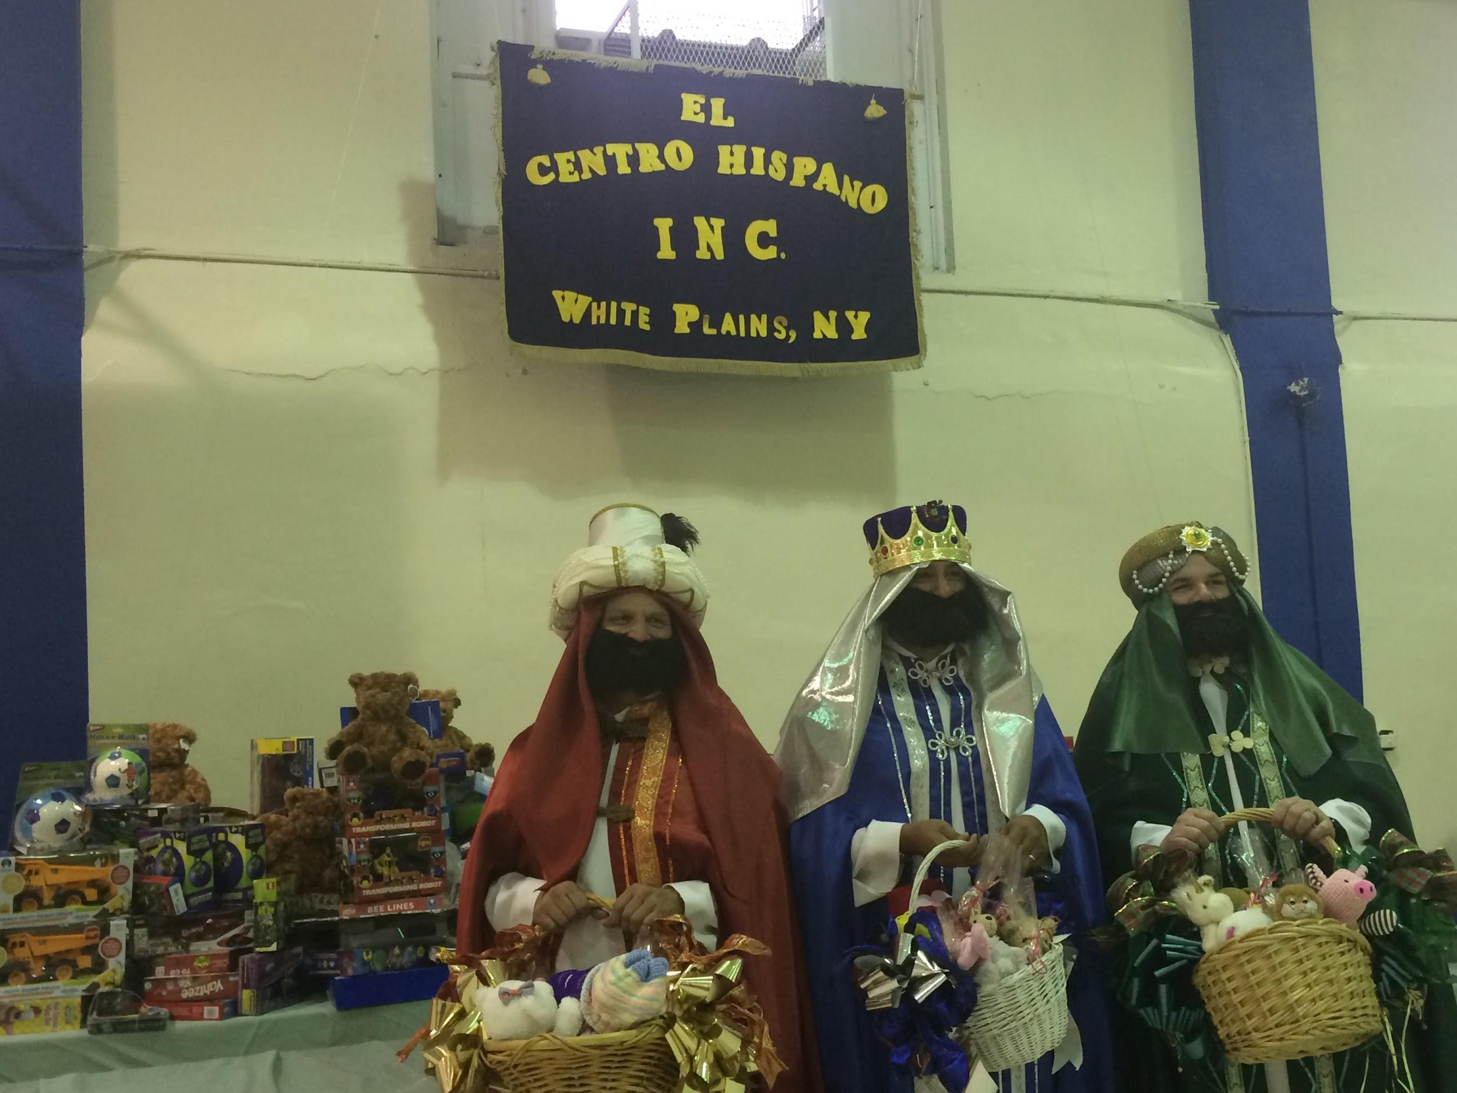

Slide 6
